Slide 1
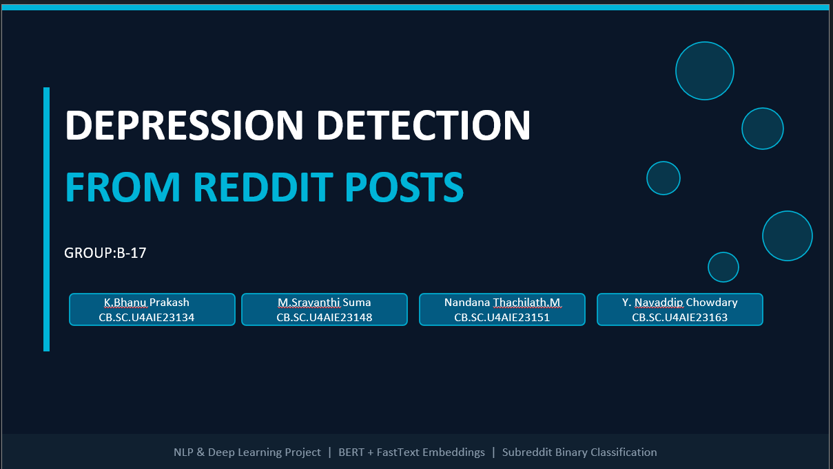

Slide 2
THE PROBLEM WE ARE SOLVING
Nowadays many people talk about their feelings and mental health on social media platforms like Reddit. Some people who are suffering from depression may express their emotions through posts or comments online.
But there are millions of posts every day, so it is very difficult for humans to read all posts and find people who might be depressed.
Our project tries to solve this problem by using Artificial Intelligence and Natural Language Processing. The system will automatically read Reddit posts and detect whether the post shows signs of depression or not.
😔
🌐
🤖
Hard to Detect
Millions Post Online
AI Can Help
People rarely say 'I am depressed' directly. It shows in their word choice — hopeless, empty, worthless, burden.
Reddit has millions of posts every day on mental health forums. No human team can read and flag them all.
A well-trained AI model can scan text and detect patterns that signal depression — quickly and at scale.
🎯 Our Goal: Train an AI to read Reddit posts and classify them as Depressed or Not Depressed.

Slide 3
WHERE DID WE GET THE DATA?
We collected posts from 5 Reddit communities (subreddits). Each post was given a label — depressed or not depressed.
🔴 DEPRESSED (Label = 1)
🟢 NOT DEPRESSED (Label = 0)
r/depression
r/teenagers
Posts about feeling hopeless, empty, unable to cope with daily life
School life, gaming, friendships — normal everyday teenage things
VS
r/Happy
r/SuicideWatch
Positive experiences, gratitude, joyful moments, good news
Posts about suicidal thoughts, feeling like a burden, wanting pain to stop
r/DeepThoughts
Philosophical curiosity and neutral reflection (not emotional distress)
Key words found:
"hopeless, worthless, empty, burden, suicidal, darkness"
Key words found:
"excited, happy, grateful, fun, gaming, blessed"
The dataset contains 831,138 posts after preprocessing.
The data is split into 80% training (664,993 posts), 10% validation (83,031 posts), and 10% test (83,114 posts).

Slide 4
HOW THE SYSTEM WORKS — 4 SIMPLE STEPS
From a raw Reddit post to a final prediction — here is the journey of the data:
Step 1: Collect & Label
Step 2: Clean the Text
Step 3:BERT Fine‑Tuning
Reddit posts were collected from 6 subreddits: depression and suicidewatch labelled as depressed (1), and teenagers, deepthoughts, and happy labelled as not depressed (0).
The dataset was balanced to have equal posts in both classes to avoid model bias, resulting in a final cleaned dataset of 831,138 posts.
Tokenization: The cleaned text is fed into BERT’s WordPiece tokenizer, which splits words into subwords (e.g., “depressed” → “depress” + “##ed”) and adds special tokens `[CLS]` and `[SEP]`.
Embedding: Each token is mapped to a 768‑dimensional vector from BERT’s pre‑trained embedding table.
Transformer Layers: The vectors pass through 12 transformer layers, where self‑attention captures context and relationships between words.
Pooling: The final hidden state of the `[CLS]` token represents the whole post.
Classification Head: A small neural network converts this representation into two class scores (depressed / not depressed), and softmax gives a confidence percentage.
Text Cleaning: Removed URLs, special characters, and Reddit patterns (like u/username and r/subreddit),
Final Output: The AI says → DEPRESSED or NOT DEPRESSED (with a confidence percentage)

Slide 5
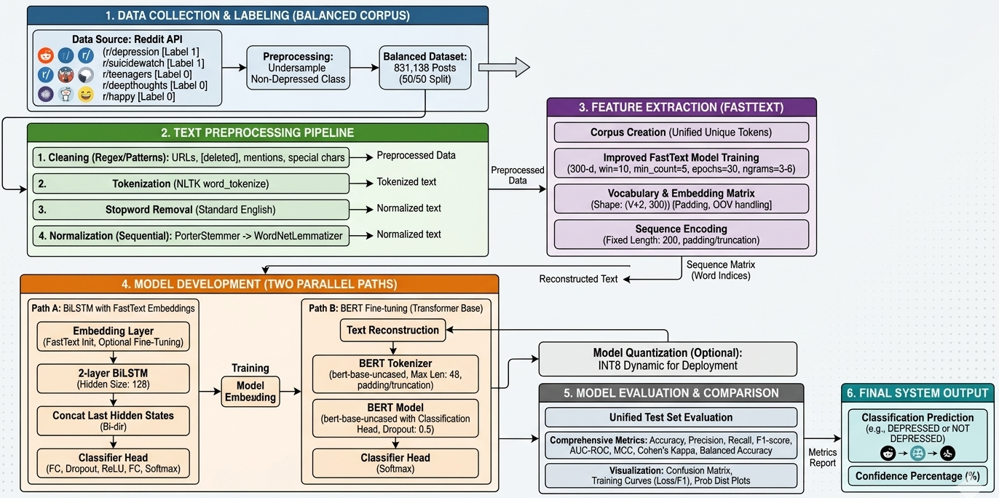


FULL SYSTEM ARCHITECTURE

Slide 6
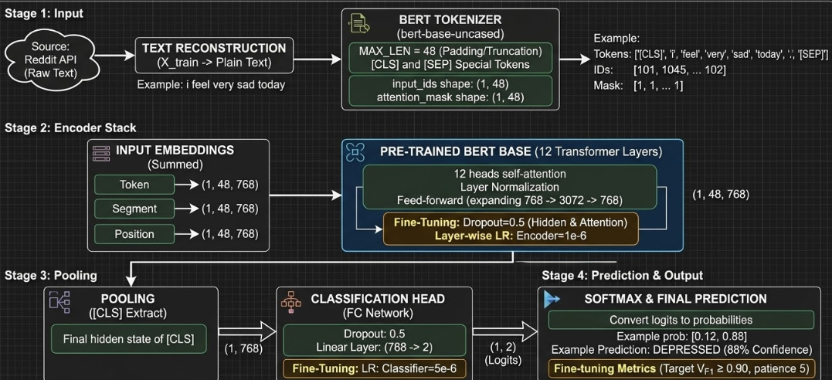
BERT INTERNAL WORKING ARCHITECTURE

Slide 7
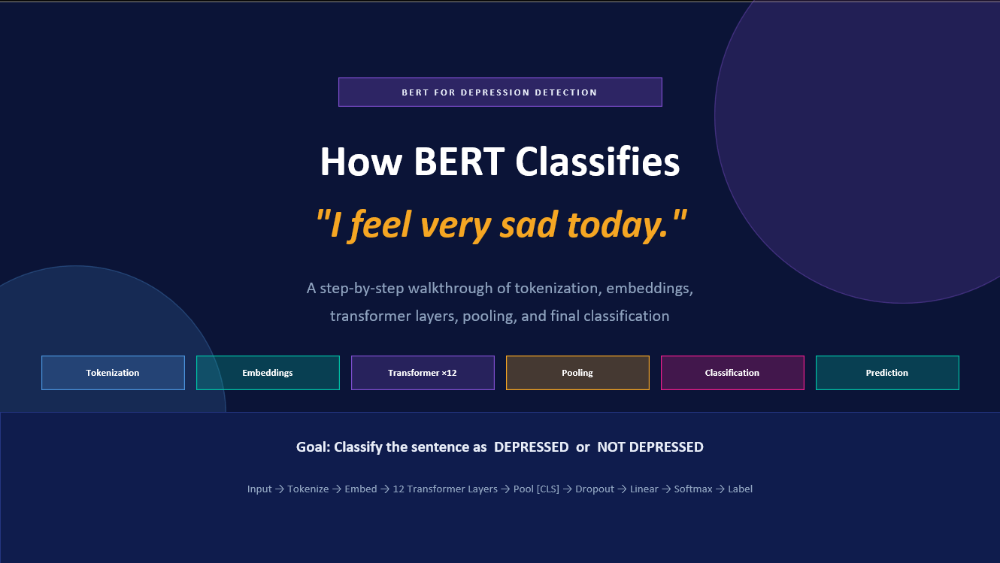
FULL SYSTEM ARCHITECTURE — BIG PICTURE

Slide 8
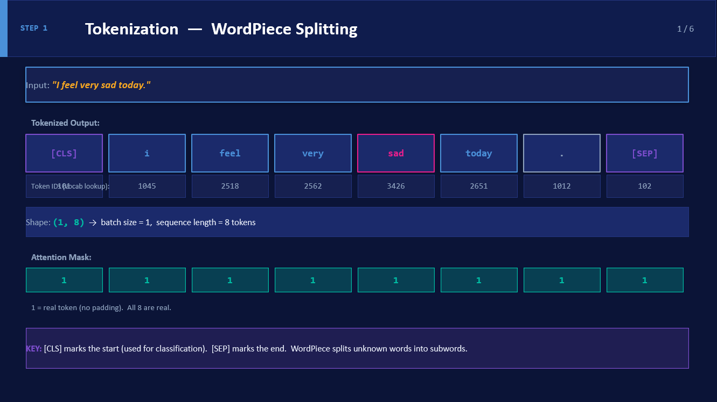
FULL SYSTEM ARCHITECTURE — BIG PICTURE

Slide 9
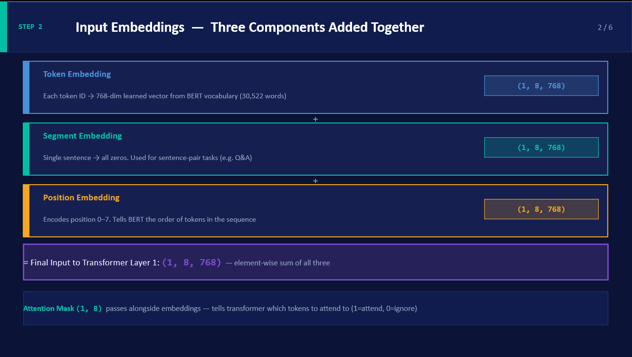
FULL SYSTEM ARCHITECTURE — BIG PICTURE

Slide 10
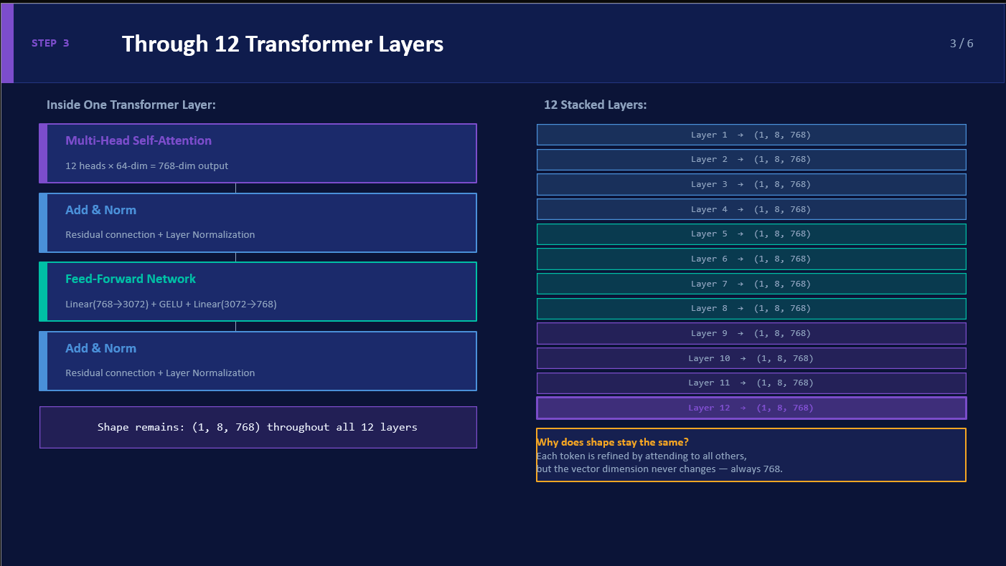

FULL SYSTEM ARCHITECTURE — BIG PICTURE

Slide 11
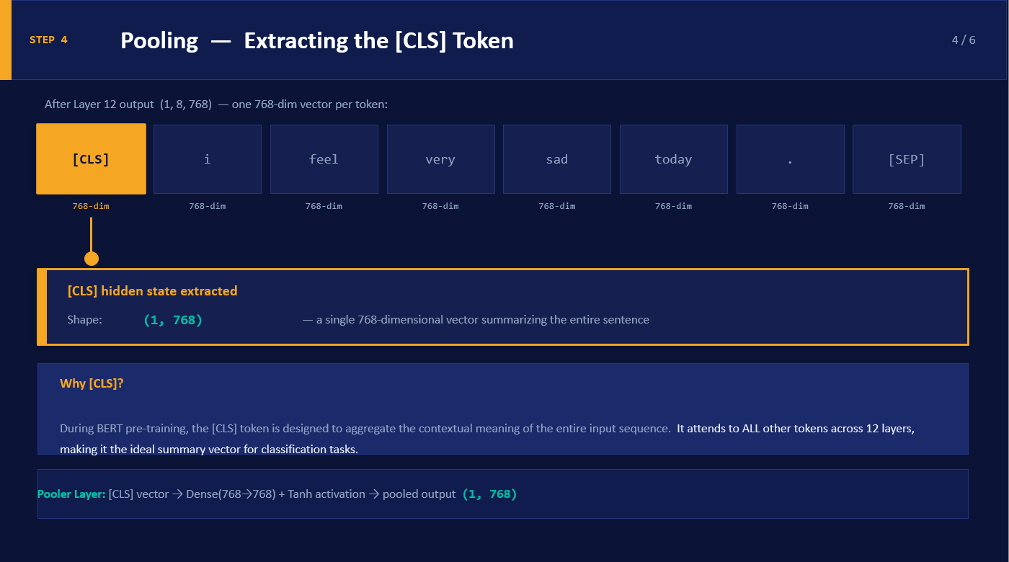
FULL SYSTEM ARCHITECTURE — BIG PICTURE

Slide 12
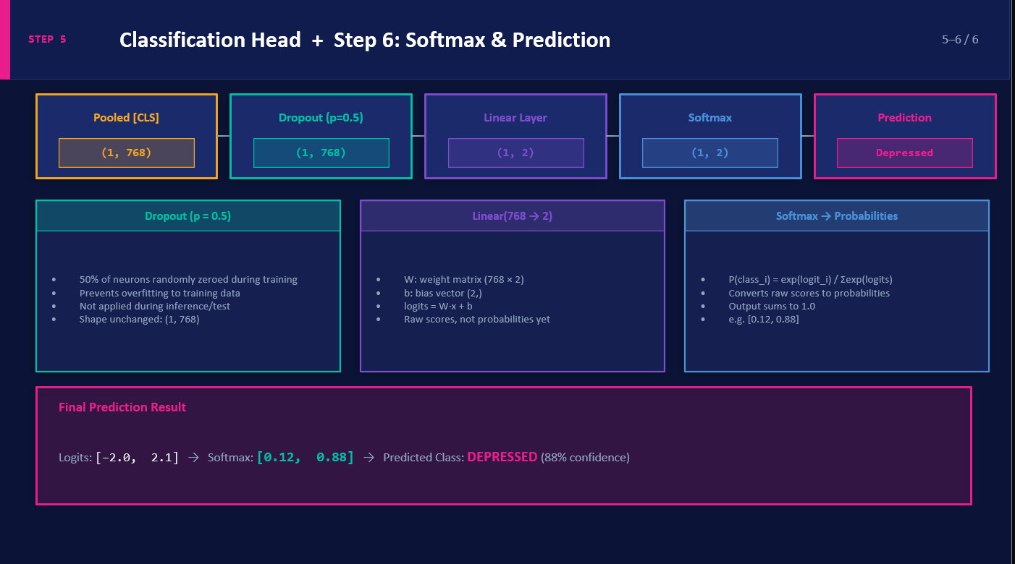
FULL SYSTEM ARCHITECTURE — BIG PICTURE

Slide 13
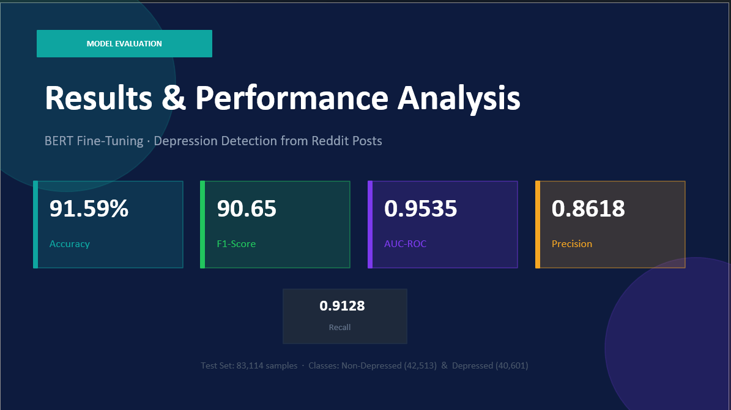
FULL SYSTEM ARCHITECTURE — BIG PICTURE

Slide 14
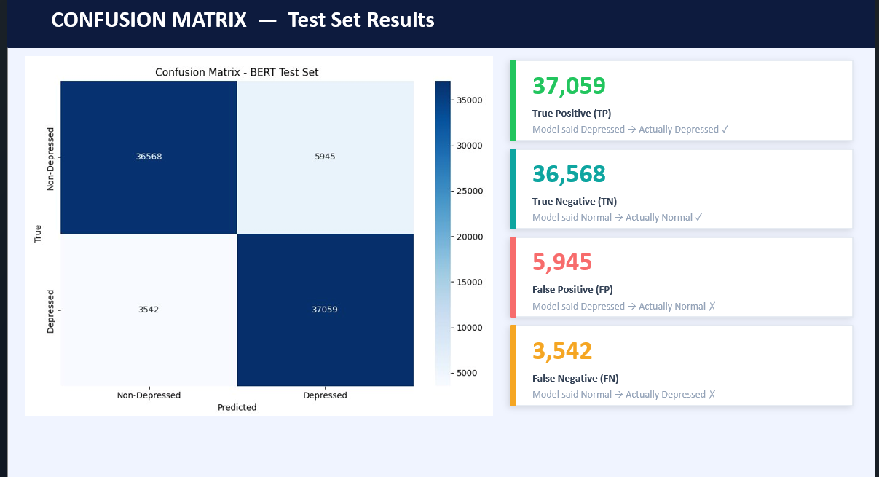
FULL SYSTEM ARCHITECTURE — BIG PICTURE

Slide 15
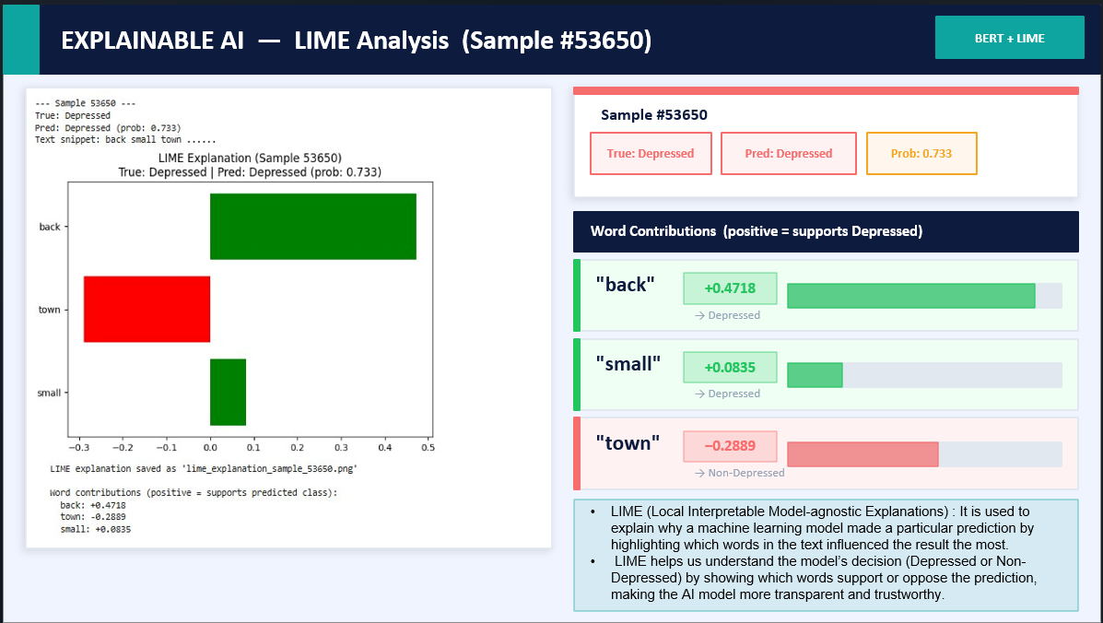
FULL SYSTEM ARCHITECTURE — BIG PICTURE

Slide 16
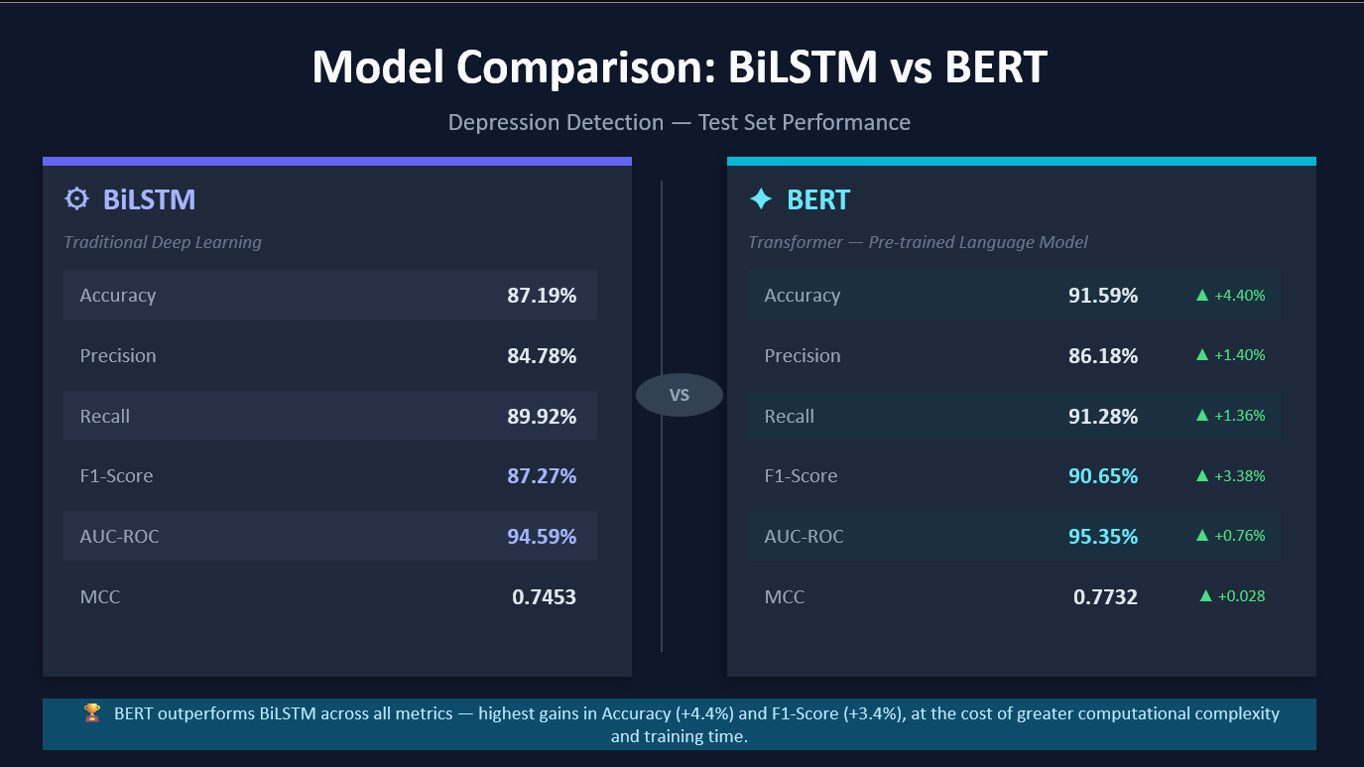
FULL SYSTEM ARCHITECTURE — BIG PICTURE

Slide 17
THANK YOU

